Slide 1


[Social Buzz IPO]

Slide 2


Today's agenda
Project recap
Problem
The Analytics team
Process
Insights
Summary

Slide 3


Project Recap
Social Buzz is the fastest growing technology unicorn
that need to adopt quickly to it’s global scale
Accenture has begun 3 month POC focusing on this task
An audit of their big data practice
Recommendations for a successful IPO
Analysis to find Social Buzz top 5 most popular categories of content

Slide 4


Problem
Over 100000 post per day
36,500,000 piece of content per year!
But how to capitalize on it when there is so much ?
Analysis to find Social Buzz top 5 most popular categories of content

Slide 5



Andrew flaming
Chief Technical Architect
The Analytics team
Marcus Rompton
Senior principle
Avinab Singh
Data analyst

Slide 6

Data understanding
Process
1
2
Data cleaning
3
Data Modelling
4
Data Analysis
5
Uncover Insights

Slide 7
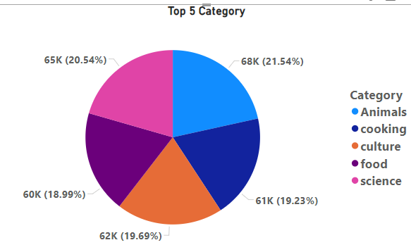
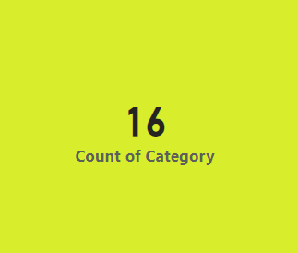


Insights

Slide 8
Unique Category
category | Count of Reaction Type
animals | 1897
cooking | 1664
culture | 1676
dogs | 1338
education | 1433
fitness | 1395
food | 1699
healthy eating | 1717
public speaking | 1217
science | 1796
soccer | 1457
studying | 1363
technology | 1698
tennis | 1328
travel | 1647
veganism | 1248
Grand Total | 24573
Animals
cooking
culture
dogs
education
fitness
food
healthy eating
public speaking
science
soccer
studying
technology
tennis
travel
veganism

Slide 9
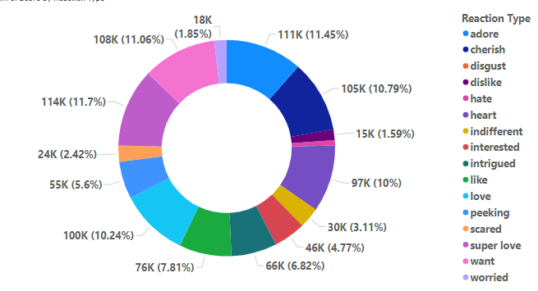
Reaction type By Score

Slide 10


First we have to understand data then clean the Data after cleaning Data Modelling then Data Analysis then give proper visualization according to their needs.
Summary

Slide 11

Thank you!
ANY QUESTIONS?

